Slide 1


Credit Risk Analysis & Insights using Power BI
Overview:
This project analyzes restaurant sales and order data to understand customer ordering behavior, menu performance, and overall business trends. Using an interactive Power BI dashboard, the analysis highlights key metrics such as total orders, total sales, and average order value to provide a clear overview of restaurant performance. The dashboard also explores ordering patterns across different times of the day and days of the week, helping identify peak business hours.
Tools Used:
Power BI Desktop
DAX (Calculated Columns and Measures)
MS SQL Server
Excel/CSV Data
By:
Ankit Rawat
Data Analyst
ankitrawat.ds@gmail.com
Linkedin

Slide 2
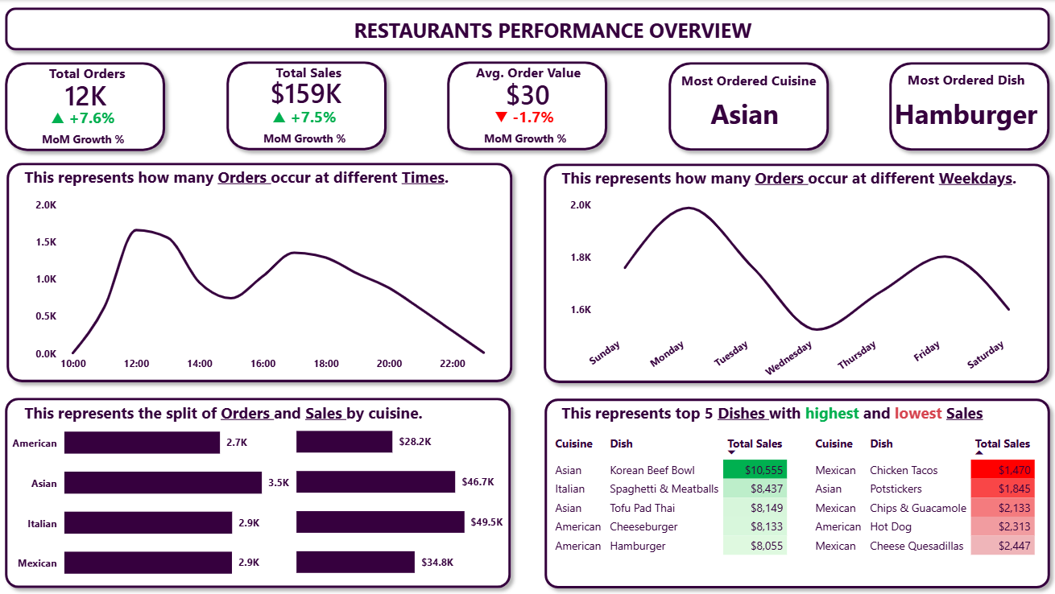

Slide 3
Meaningful Insights
Strong Growth in Orders and Revenue
The restaurant processed 12K total orders, generating $159K in sales, with both metrics showing over 7% month-over-month growth. This indicates increasing customer demand and positive business momentum.
Decrease in Average Order Value
Although orders and sales are increasing, the average order value has slightly decreased by 1.7%. This may indicate that customers are ordering fewer items per transaction or choosing lower-priced menu items.
Lunch and Evening Are Peak Ordering Times
Order activity peaks around 12 PM during lunch hours and again between 5 PM and 7 PM during dinner hours. This suggests that these time periods represent the restaurant’s highest demand windows.
Monday Is the Busiest Day
Among all weekdays, Monday records the highest number of orders, while Wednesday shows the lowest demand. Order volume also increases again towards Friday, likely due to customers preparing for the weekend.
Asian Cuisine Is the Most Popular
Asian cuisine receives the highest number of orders (3.5K), indicating strong customer preference for this category. However, Italian cuisine generates the highest revenue ($49.5K), suggesting higher-priced dishes or larger order sizes.
Revenue Contribution Differs by Cuisine
While Asian cuisine leads in order volume, Italian cuisine produces higher revenue, suggesting that Italian dishes may have higher average prices or higher-value orders.

